Slide 1
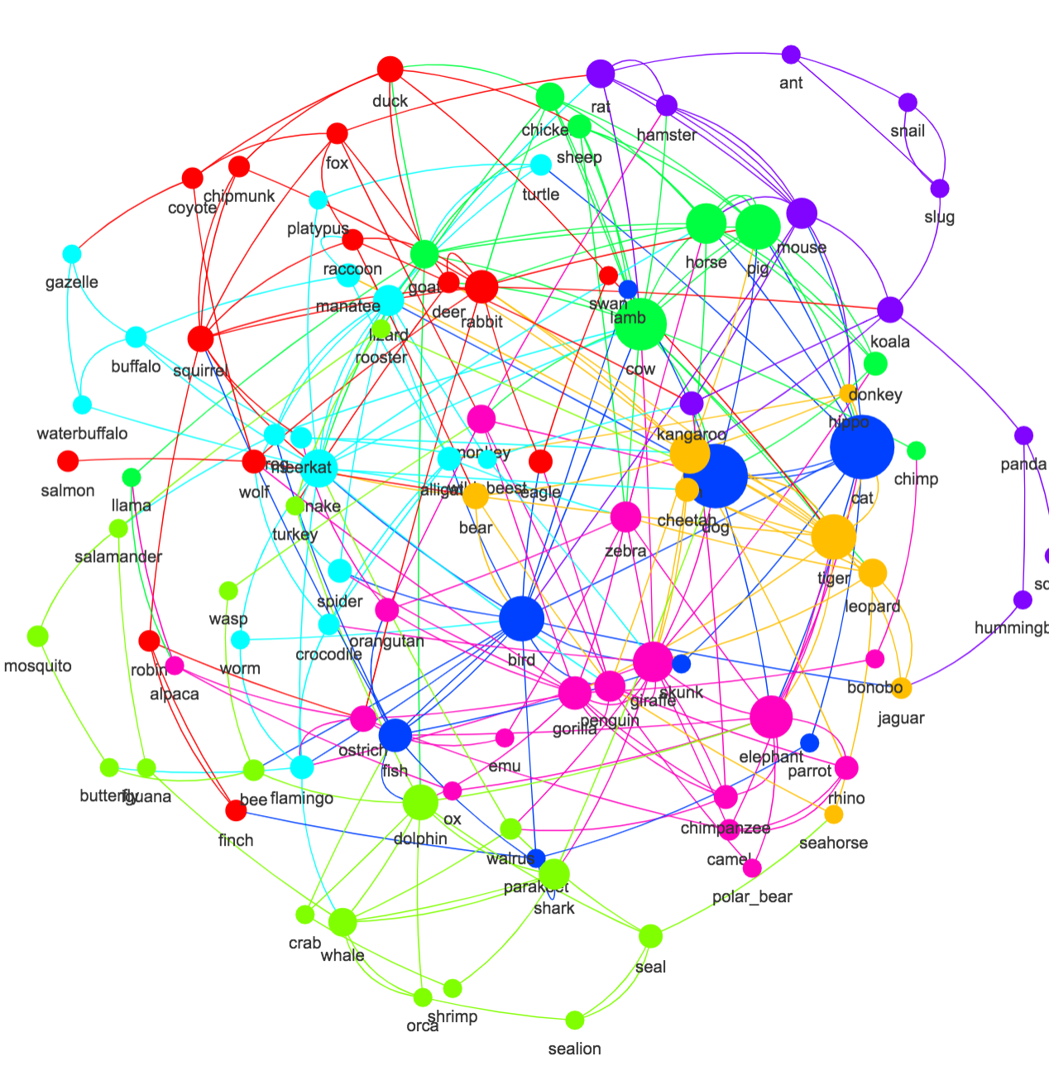
Semantic Networks
Knowledge-based System Engineering
Intelligent Information Management Laboratory
Laboratorium Manajemen Cerdas Informasi

Slide 2
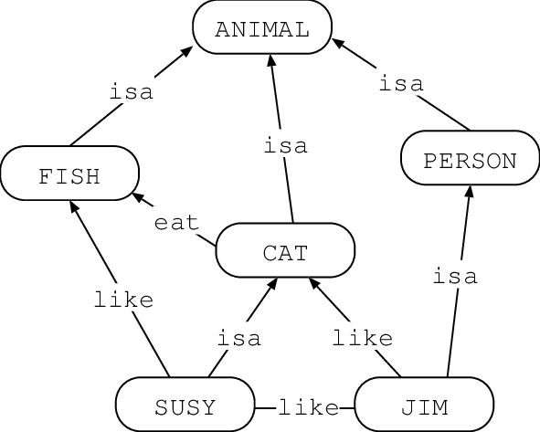
Semantic Networks
Semantic Networks is graph structure with nodes (concepts) and edges (relationships)
It represents associative knowledge in a simple, visual way
Components of Semantic Networks
Nodes: Concepts/Classes/Entities (e.g., “Person”, “Fish”)
Arcs/Labeled Edges: Semantic Relationships (e.g., “isa”, “like”)
Attributes: Properties of nodes (e.g., “height=175”)

Slide 3
Semantic Networks vs Ordinary Graph
An ordinary graph only provides nodes and edges. A semantic network gives those elements a knowledge-representation interpretation: nodes denote concepts or entities, and edge labels express semantic relations.

Slide 4
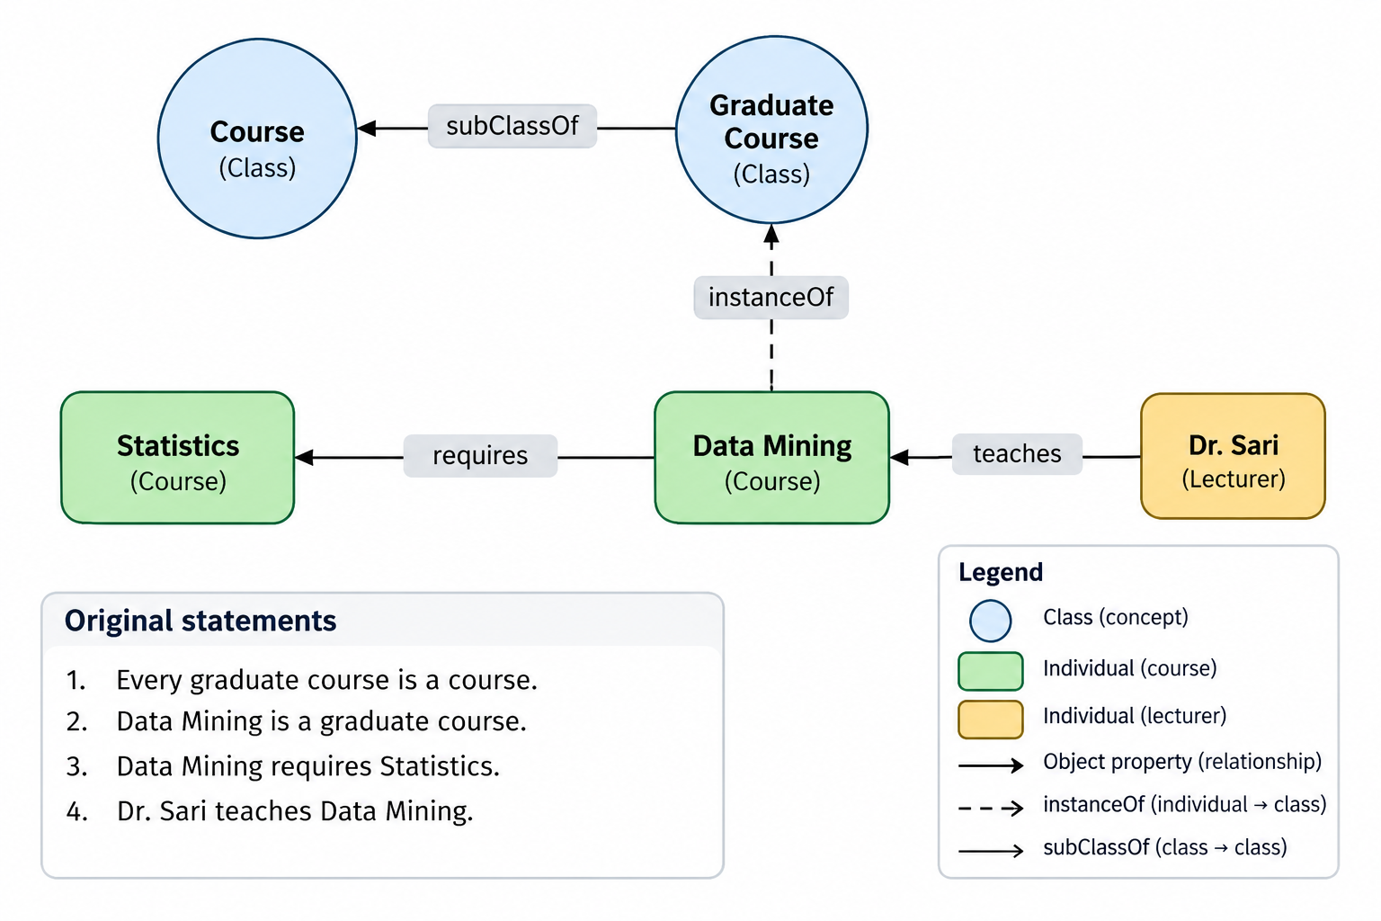
Natural Language to Network

Slide 5
SN Core Components
Component | Meaning | Example
Concept | General category | Course
Instance | Particular entity | DataMining101
Relation | Semantic connection | HAS-PREREQUISITE
Attribute | Property of an entity | credits = 3
Hierarchy | Taxonomic organization | GraduateCourse IS-A Course

Slide 6
Classes (Concepts)
General categories or types of things in the domain.
➔ In other words, Classes are high-level concepts that group similar entities.
Purpose: Define the types of objects in the domain
✅ Classes provide the taxonomy of your knowledge base — they define what kinds of things exist.
Example: Person, Book, Author, Publisher, Genre
Note: Author might be a subclass of Person, showing hierarchical structure

Slide 7
Instances (Individuals)
Specific, real-world entities that belong to classes.
➔ So it is specific, real-world entities that belong to classes.
Purpose: Represent concrete objects in the world (e.g., "Person", "Book", "Publisher).
✅ Instances allow ontologies to represent real data, not just abstract ideas..
Example:
JK Rowling is an instance of Person
Harry Potter is an instance of Book
Bloomsbury is an instance of Publisher

Slide 8
Attributes (Properties)
Characteristics or features of classes/instances.
➔ Properties describe attributes or values associated with instances.
Types:
Data properties: Link instances to literal values (e.g., strings, numbers).
Object properties: Link instances to other instances.
✅ Attributes let you attach meaningful information to entities and express relationships between them
Example:
JK Rowling country of origin United Kingdom
Harry Potter 1 no page 223

Slide 9
Relationships
Types of relationships
Relationships give meaning to the network. Choosing the right type is crucial for accurate representation and reasoning.
Hierarchical (Taxonomic) Relationships
Part-Whole (Mereological) Relationships
Functional & Action-Based Relationships
Spatial & Temporal Relationships
Attribute-Value Relationships
Associative (Generic) Relationships
Example
Family Relationship:
  [John] --father-of--> [Mary]
  [Mary] --mother-of--> [Tom]
  [John] --spouse-of--> [Mary]
Who is Tom’s grandfather?

Slide 10
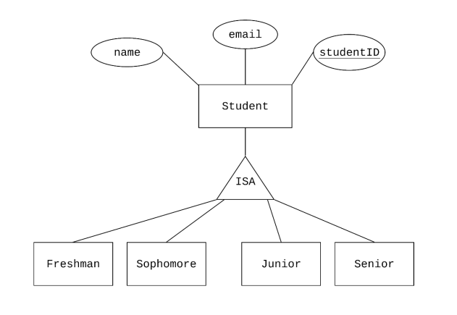
Hierarchical (Taxonomic) Relationships
These define class-subclass or kind-of relationships, forming a hierarchy.
is-a / instance-of
    Sparrow is-a Bird → Inheritance of properties
    Tweety instance-of Sparrow → Individual membership
subClassOf / superClassOf
    Formal version used in ontologies
    Enables inheritance reasoning

Slide 11
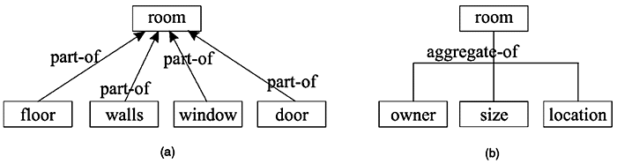
Part-Whole (Mereological) Relationships
Represent composition or decomposition of objects.
part-of
    Wheel part-of Car
    Chapter part-of Book
has-part (inverse of part-of)
    Car has-part Engine
Transitive: If Piston part-of Engine and Engine part-of Car, then Piston part-of Car
Asymmetric: If A is part of B, B cannot be part of A
This is the backbone of categorization. It allows systems to infer that a sparrow breathes, because birds do.

Slide 12
Functional & Action-Based Relationships
Describe what entities do or how they interact.
performs / capable-of
    Bird capable-of Flying, Doctor performs Surgery
uses
    Student uses Laptop, Chef uses Knife
eats / consumes
    Lion eats Zebra, Human consumes Water
These relationships support behavioral modeling and are key in expert systems and simulation.

Slide 13
Spatial & Temporal Relationships
Capture location and time-based associations.
Spatial:
  Paris located-in France
  Book on Table
  Hospital near Airport
Temporal:
  Event1 before Event2
  Meeting during Lunch
  Winter follows Autumn
These are essential in geospatial systems, planning, and narrative understanding in NLP.

Slide 14
Associative (Generic) Relationships
Used when no specific relationship type fits — but should be used sparingly.
related-to
  Coffee related-to Morning, Music related-to Mood
causes / leads-to
  Smoking causes Cancer, Rain leads-to Flood
opposite-of / similar-to
  Hot opposite-of Cold, Cat similar-to Dog
Overuse of related-to weakens the network’s clarity and reasoning power.

Slide 15
Instance-Of Relationships
Used to illustrate How an individual entity connects to its class.
Example: DataMining101 INSTANCE-OF GraduateCourse
Overuse of related-to weakens the network’s clarity and reasoning power.

Slide 16
Inheritance
Subclasses inherit properties from superclasses
Example: If “Bird” can-fly = true, then “Sparrow” can-fly = true
Default inheritance vs. exceptions (e.g., Penguins are birds but can’t fly)
Types of Inheritance
Single Inheritance: One parent
Multiple Inheritance: Multiple parents
Semantic Inheritance: Follows meaning (not just structure)

Slide 17
Semantic Network Limitation
Ambiguous relation meanings without formal definitions.
No universal inference mechanism.
Difficulties representing quantifiers, negation, uncertainty, and exceptions.
Need for explicit constraints and consistency checking in complex domains.
Challenges integrating heterogeneous knowledge sources.

Slide 18
Exercise: Draw Semantic Network
Exercise 1:
  Every cardiologist is a doctor.
  Dr. Andi is a cardiologist.
  Dr. Andi treats Patient Budi.
  Patient Budi has Disease X.
  Every disease is a medical condition.
Exercise 2:
  Every bus is a vehicle.
  Every train is a vehicle.
  Bus A is a bus.
  Train B is a train.
  Bus A connects Station X to Station Y.
  Train B connects Station Y to Station Z.
  Station X is located in City P.
  Station Z is located in City P.

